Slide 1
Mesos Introduction
Module 8

Slide 2
Module Objectives
After this module, participants will be able to:
Understand how Mesos solves issues with distributed computing
Understand Zookeeper
Learn about Mesos architecture
Understand various components of Mesos system
Notes:
Instructor Notes:
Please review the course objectives with students. Also, ask them why they are taking this course and what are they hoping to achieve.
Participant Notes:

Slide 3
Introducing Mesos
Notes:
Instructor Notes:
Participant Notes:

Slide 4
A Little History
2004
2005
200x
2011
Google MapReduce paper
Hadoop: Open source implementation of Google MapReduce paper by Doug Cutting
BORG – Google's system
Mesos paper "Mesos: A platform for fine grained resource sharing in the data center"
Notes:
Instructor Notes:
The history simply sets the stage, and you can expand on it as much as you want. But our goal is to just lead up to Mesos.
Participant Notes:
We show some important milestones in distributed computing.
2004 Google Map Reduce paper led to open source software of Hadoop.
Similarly Google's BORG inspires Mesos.

Slide 5

A Case for Mesos
There are many applications running on our laptops, including:
A Web browser
And Eclipse (Java programmer's IDE – Integrated Development Environment)
When we are actively browsing the Web our browser is using more resources (it uses more CPU cycles and also consumes more memory).
Now, we switch to Eclipse and compile a large Java project.
Eclipse will need to use more resources (CPU/Memory/Disk) than the other programs.
However, we usually don't notice this (on a reasonably fast computer). Why?
The Operating System (MacOS/ Windows / Linux) automatically takes care of balancing application resource requirements based on usage.
Notes:
Instructor Notes:
Do a quick demo:
Bring up 'Activity Monitor' or 'Resource Monitor' on your laptop.
Show the running applications and their CPU/Memory usage.
Participant Notes:
Modern Operating Systems such as MacOS, Windows and Linux can run multiple applications concurrently.
This is called 'Multi Tasking'.
Many applications can run side by side, without affecting each other.
Advanced Operating Systems like Linux/Unix can host multiple users (each users running multiple applications) simultaneously.

Slide 6
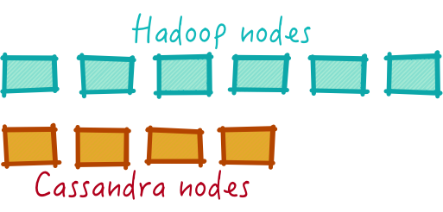
A Case for Mesos (Cont.)
Let's move from our laptop to our data center.
Assume we have 10 machines:
6 machines are dedicated to Hadoop
4 machines are dedicated to Cassandra
Once these machines are setup the cluster size is 'static'.
I can not easily change Hadoop/Cassandra cluster size according to my needs.
This would require 're-provisioning' machines with totally different configuration – that can be a pretty involved task.
We are not really utilizing our hardware (data center) properly.
What we need is "OS for Datacenter"
Notes:
Instructor Notes:
Instructor Notes are the same as Participant Notes.
Please present the Participant Notes.
Participant Notes:
Hadoop is a distributed storage/compute system. Invented by Yahoo and now an open source Apache project.
Hadoop 'democratized' Big Data processing.
http://Hadoop.apache.org
Cassandra is a distributed NoSQL database. It was invented at Facebook and open sourced.
Cassandra is used for large-scale data storage.
http://Cassandra.apache.org

Slide 7

Mesos
In 2011 Berkeley AMP Lab published Mesos paper:
"Mesos: A platform for fine grained resource sharing in the data center"
Mesos was designed to be "an Operating System for the Data Center".
Mesos's goal: Program the data center.
The Mesos paper demonstrated that the authors were able to effectively share a cluster with Hadoop and MPI.
Twitter hires Mesos principal designer, and Mesos becomes part of Twitter's core infrastructure, managing thousands of machines across services.
Notes:
Instructor Notes:
Instructor Notes are the same as Participant Notes.
Please present the Participant Notes.
Participant Notes:
In 2011 the Berkeley AMP lab was in full swing. This is the group that today has brought us Spark, Tachyon, and many other distributed, scalable systems.
One of the projects they were working on was Mesos.
Companies like Google and Yahoo! are interested in the AMP lab, because they’re working on similar problems. The team at Twitter take it a step further: they realize that Mesos solves a critical problem with which they’ve been struggling. So they hired the lead author Ben Hindman Ph.D. to build Mesos as a more complete system.

Slide 8
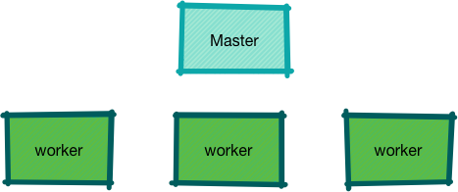
Distributed System Design
Here is the Master/Worker design.
What if the master fails?
Notes:
Instructor Notes:
Instructor Notes are the same as Participant Notes.
Please present the Participant Notes.
Participant Notes:
Master-Worker architecture is a pretty popular principal in distributed system design.
Many distributed systems follow this architecture.
Examples include: Hadoop, Spark, HBase.
One of the reasons the Master-Worker design is popular is, it simplifies the system design.
However, the design has an inherent flaw – the Master can be a single point of failure.

Slide 9
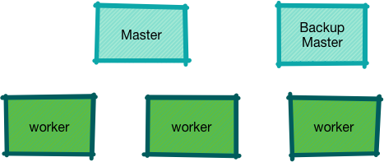
Distributed System Design – Active-Passive Design
If the master fails?
Backup master will take over.
What if the backup master fails?
Notes:
Instructor Notes:
Instructor Notes are the same as Participant Notes.
Please present the Participant Notes.
Participant Notes:
Since Master is potentially a 'single point of failure' in the design, there is a 'backup master' setup.
This design is called 'active-passive' design.
The backup will automatically take over when the active master fails.
You can ask the question, what if the backup master also fails. Then we would need a backup for the backup.
You get the picture.

Slide 10
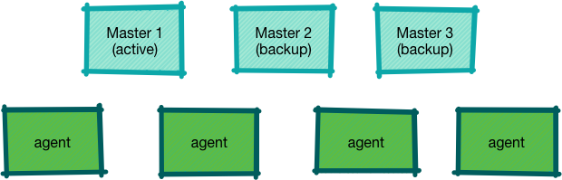
Mesos Design
Mesos is designed not to have a single point of failure.
It extends the active-passive master design.
Mesos allows multiple masters (more than 2).
Notes:
Instructor Notes:
Instructor Notes are the same as Participant Notes.
Please present the Participant Notes.
Participant Notes:
Here we are showing a multi-master setup of Mesos.
Mesos can support multiple standby masters. Only one master is selected as active.
Other masters are on standby.
Who selects the active master?
Zookeeper keeps track of active master.
We will look at zookeeper next.

Slide 11
Zookeeper
Notes:
Instructor Notes:
This is a quick section on Zookeeper
Participant Notes:

Slide 12
Brief History of Distributed Computing
1900s
Single core processors.
Programs ran in single ‘thread’ mode.
The game was faster and faster clock speeds (200MHZ ).
2000s
Multi -ore processors come into the market.
Multiple threads or programs can run simultaneously on cores.
Imagine two threads are trying to update a counter.
How can we prevent race conditions? We use synchronization mechanisms like:
Locks, mutex, and semaphores.
Notes:
Instructor Notes:
Instructor Notes are the same as Participant Notes.
Please present the Participant Notes.
Participant Notes:
Before 2000, we had single core CPUs. And only ONE program can really execute at any time.
Operating systems like Windows / Linux they manage multiple applications.
OS would schedule one application on the CPU at a time. They would switch another application after a few milliseconds.
This gives an 'illusion' of multiple applications running at the same time.
But really there is ONLY one application running at any given moment.
In early 2000s multi-core processors were introduced.
Initially, these are adopted by high-end systems used by gamers and graphic designers.
As the cost of these multi-core systems came down, they became commonplace.
Languages like Java made programming multiple cores easy.
Java has built-in mechanisms for creating and managing threads.

Slide 13
Brief History of Distributed Computing (Cont.)
Now we have Distributed systems with:
Multiple nodes.
Each with multiple cores.
How do we coordinate them all?
Notes:
Instructor Notes:
Instructor Notes are the same as Participant Notes.
Please present the Participant Notes.
Participant Notes:
A system like Cassandra (a NoSQL database) runs on multiple servers. Each node, it would run on multiple CPU cores.
So if we are incrementing a counter, imagine what kind of coordination we have to do?
Not only we have to synchronize across multiple cores on one node, but we need to synchronize across multiple nodes also.
This is a common problem we need to solve when building distributed systems.
This is where Zookeeper comes in.

Slide 14

Distributed System Problem: Leader Election
There can only be ONE !
Notes:
Instructor Notes:
Instructor Notes are the same as Participant Notes.
Please present the Participant Notes.
Participant Notes:
One of the problems we need to solve for distributed systems is 'leader election'.
Zookeeper can help with that.
We will see how in the next slides.

Slide 15
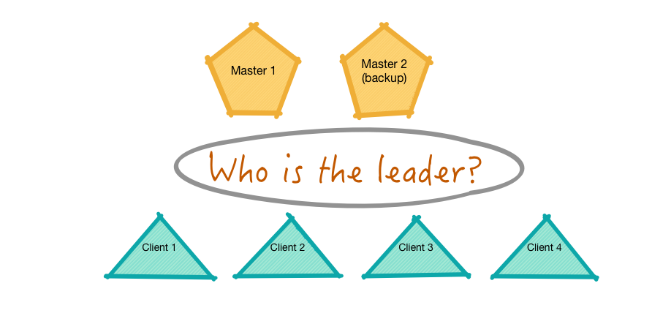
Distributed System Problem: Leader Election
Notes:
Instructor Notes:
Instructor Notes are the same as Participant Notes.
Please present the Participant Notes.
Participant Notes:
In this scenario, we have a database with an active master and a backup.
When clients connect, they connect to the active master.
However, how can a client know which of the masters is active?

Slide 16
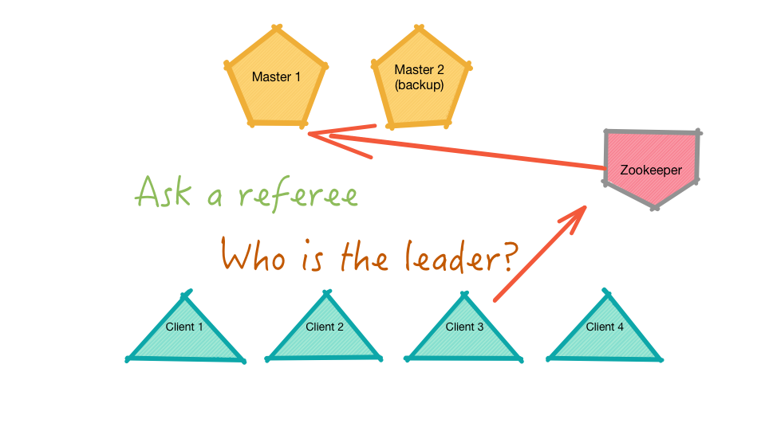
Distributed System Problem: Leader Election (Cont.)
Notes:
Instructor Notes:
Instructor Notes are the same as Participant Notes.
Please present the Participant Notes.
Participant Notes:
Continuing with the scenario, it is hard for the clients to choose the active master.
So the clients ask a 'referee' – Zookeeper.
Zookeeper keeps track of masters and it will elect the active master.

Slide 17
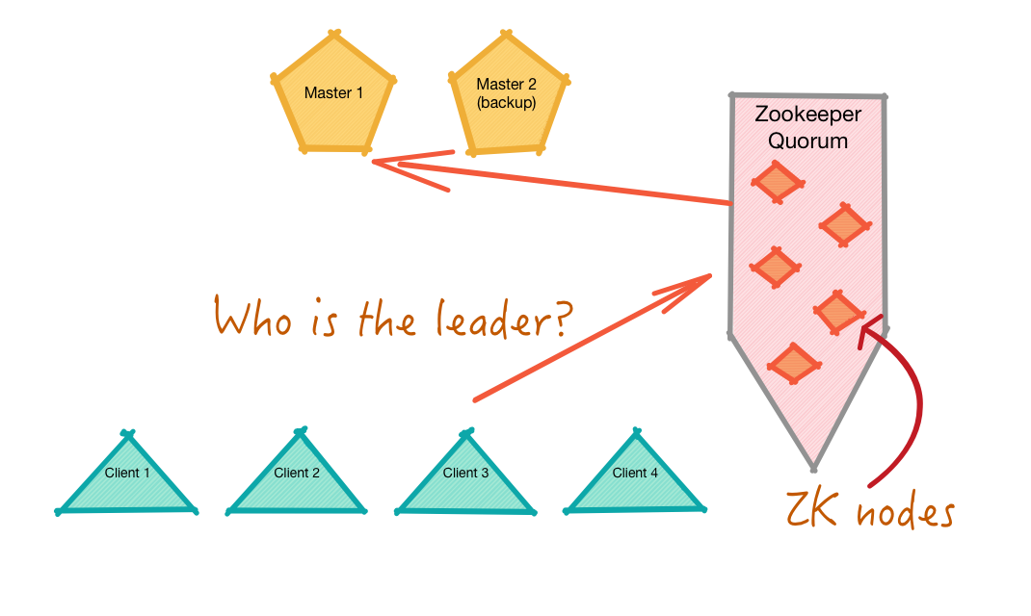
Zookeeper Cluster/Quorum
What if ZK goes down?
Run ZK as a cluster - ‘quorum’
No single point of failure
Notes:
Instructor Notes:
Participant Notes:
Now that Zookeeper (ZK) is part of our infrastructure, we need to make it stays up.
So ZK runs as a cluster – on multiple machines.
In production, ZK runs on three or more nodes.
So even if ZK nodes crash, the ZK service stays up.
One example to think about is Google search.
These days, we don't use bookmarks much. We just search on Google.
Google Search runs on thousands of machines. Even if a few of those machines are down, the 'Search Service' keeps functioning.
Can you imagine a day without Google?

Slide 18

Zookeeper Services
Zookeeper provides the following services:
1
Configuration
2
Synchronization
3
Name Registry
4
Consensus
5
Leader Election
Notes:
Instructor Notes:
Instructor Notes are the same as Participant Notes.
Please present the Participant Notes.
Participant Notes:
In previous slides, we saw how ZK does leader election.
But ZK does more than leader election. Some of the services are listed here.
Zookeeper was created along with Hadoop to provided distributed coordination services.
It was then spun off as its own project.
Now ZK is used in many open source projects.

Slide 19

Zookeeper Runtime
Zookeeper runs as a quorum - multiple nodes:
No single point of failure.
An odd number of nodes (3, 5, 7, etc.).
Minimum of 3 nodes in production setups.
A small number of nodes can support thousands of clients.
Notes:
Instructor Notes:
Instructor Notes are the same as Participant Notes.
Please present the Participant Notes.
Participant Notes:
Odd number ZK nodes are used to break the tie when voting.
For example in a leader election scenario, if two nodes say 'A' is the leader, and another node says 'B' is the leader, the majority vote wins; and 'A' is elected as leader.
Zookeeper implements a consensus protocol called ‘ZAB’ - Zookeeper Atomic Broadcast. Similar to PAXOS protocol.
ZAB paper : http://web.stanford.edu/class/cs347/reading/zab.pdf
Paxos : https://en.wikipedia.org/wiki/Paxos_(computer_science)

Slide 20
Mesos Architecture
Notes:
Instructor Notes:
Participant Notes:

Slide 21
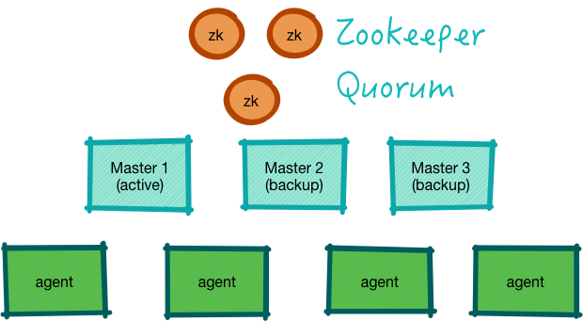
Mesos with Zookeeper
Notes:
Instructor Notes:
We are building up to the final Mesos Architecture.
Participant Notes:
Here we are adding Zookeeper to our Mesos.
Mesos uses Zookeeper's leader election facility to select an active master.

Slide 22
Mesos Components
Master
Agent
Zookeeper
Framework Scheduler
Framework Executor
Coordinator for the cluster.
Runs on worker nodes.
Manages applications running on worker nodes.
Helps with leader election and coordination of the cluster.
Negotiates with the Master to acquire resources.
Runs applications on the worker node.
Notes:
Instructor Notes:
These are the components that make up Mesos cluster.
We will discuss them in detail in next section
Participant Notes:
We have seen Mesos master, agent and zookeeper.
Next, we are going to see how an application works on a Mesos cluster.

Slide 23

Mesos Master
Mesos Masters are the brain of the cluster.
Master's responsibilities include:
They are the central source of truth for running tasks.
They fairly share the cluster between all the connected frameworks.
They host the primary UI for the cluster. (see next slide for UI screenshot)
Masters ensure high availability and efficient allocation of resources. Masters are a single point of failure, but Mesos automatically handles master failures.
Notes:
Instructor Notes:
Instructor Notes are the same as Participant Notes.
Please present the Participant Notes.
Participant Notes:
Masters are the central source of truth for all running tasks.
In order for masters to be able to serve the UI and data about tasks with minimal latency, all task metadata is kept in memory. This means that the nodes that run the masters should have plenty of memory—on a cluster with thousands of concurrent tasks, the masters could, for instance, consume 20 GB of RAM.
Masters fairly share the cluster between connected frameworks.
The masters are responsible for offering resources to frameworks. Since the masters know exactly which frameworks are using which resources, they’re able to determine which frameworks are using less than their share, and give those frameworks the first choice of free resources.

Slide 24
Mesos Master UI
Notes:
Instructor Notes:
Instructor Notes are the same as Participant Notes.
Please present the Participant Notes.
Participant Notes:
Masters host the primary UI
When you want to use a browser to inspect and interact with the Mesos cluster, you’ll typically first visit the master UI, which is on port 5050 by default. This UI allows you to see how many resources are available in total on your cluster, and how many are used.

Slide 25

Mesos Masters High Availability
A single Mesos master would be a single point of failure. We would run multiple masters -- three or five masters: as long as a majority of the masters are still running, the cluster can continue to operate as normal.
The masters synchronize data about cluster status among themselves. Since all masters have the same up-to-date view, any one of them can service and process requests.
Only one master is elected leader at a time, and the leader can make decisions very quickly.
When a majority of the masters are lost, the Mesos cluster will operate in a safe mode.
No new applications can be submitted to the cluster in safe mode.
However, already running applications will continue to run and exit normally.
Notes:
Instructor Notes:
Instructor Notes are the same as Participant Notes.
Please present the Participant Notes.
Participant Notes:
The masters use the battle-tested Paxos algorithm to durably synchronize their beliefs about the status of the cluster. Since all masters have the same up-to-date view, any one of them can service and process requests.
Paxos algorithm is implemented by Zookeeper.
Mesos seeks to enable building highly scalable clusters, which means being able to rapidly manage thousands of cluster allocations. To accomplish this, only one master is elected leader at a time. The leader is thus able to efficiently compute and make decisions about resource allocations, without being slowed down by waiting for the other masters on every decision

Slide 26

Mesos Agents
Before v1.0 'agents' were called 'slaves‘:
.
They launch and manage the containers that host the executors (both LXC containers and Docker images).
They provide a UI to access data from within the containers.
They communicate with their local executors in order to manage communications with the Mesos masters.
They advertise information about the hosts they’re running on, including information about running tasks and executors, available resources, and other metadata.
They manage status updates from their tasks. They checkpoint their state to enable rolling restarts of the cluster.
Notes:
Instructor Notes:
Instructor Notes are the same as Participant Notes.
Please present the Participant Notes.
Participant Notes:
Container management
Mesos provides the best multitenancy isolation story for large clusters to date. It does so through the use of containerization technology. Containers are a lightweight, extremely low-resource way to guarantee specific programs access to specific quantities of resources.
For instance, a container could guarantee that a web server always can use 2 CPUs, 1 GB of RAM, and 500 MBps of network bandwidth, regardless of the demand of any other application on the machine.
Mesos slaves have deep integration with LXC, the standard Linux Containers technology, as well as with Docker, the most popular packaging and containerization technology.
UI for slave-specific data
Just as the Mesos master UI exposes information about the state of the whole cluster, such as all the active tasks and frameworks, the agent UI exposes information about what’s happening on a specific agent.
Advertising information about their host
In Mesos, it is up to each agent to self-report the amount of resources it has available for running tasks. This design makes it trivial to add new capacity to a Mesos cluster: once a agent machine is started and the Mesos agent process connects to the masters, the agent chooses to communicate what resources it’s making available to the cluster.
Rolling restarts
Mesos agents have a feature called checkpointing: the agent can periodically write snapshots of its own state plus the state of its tasks and executors, so that when you restart the agent process, rather than killing all of its tasks and executors, the new, upgraded version of the agent can simply read the checkpoint files and pick up where the previous version left off by reconnecting to the existing executors. This way, a rolling reboot of your agent can be done quickly, and not a single task need die.

Slide 27

Mesos Resources
The fundamental abstraction in Mesos is that of the resource.
Tasks and executors consume resources while performing their work.
The standard resources are CPUs, mem (memory), disk, and ports.
Notes:
Instructor Notes:
Instructor Notes are the same as Participant Notes.
Please present the Participant Notes.
Participant Notes:
Resource explanations:
cpus
This resource expresses how many CPU cores are available. Tasks may use fractional parts of a CPU—this is possible because Mesos slaves use CPU shares, rather than reserving specific CPUs.
The benefit of using CPU shares is that some task would be able to utilize more than its share, if we have an idle CPU.
mem
The mem is how many megabytes of memory are available. Unlike CPUs, which can burst to use more than their allocation if there’s spare capacity, memory is a strictly preallocated resource.
disk
The disk represents the amount of scratch space (in megabytes) that should be available in the container’s sandbox.
ports
Many tasks, such as HTTP servers, will want to open one or more ports, so that they can listen for incoming connections.
Since each port can only be bound to one task, Mesos helps by allowing tasks to reserve specific ports, so that each task uses a nonconflicting range.

Slide 28
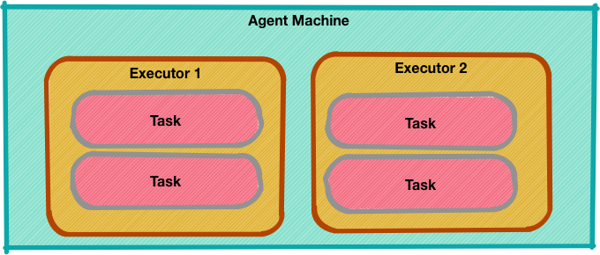
Executors and Tasks
When a scheduler wants to do some work, it launches an executor.
The scheduler can decide to send one or more tasks to an executor.
Executor will run those tasks independently.
Executor will also send status updates to the scheduler.
Notes:
Instructor Notes:
Instructor Notes are the same as Participant Notes.
Please present the Participant Notes.
Participant Notes:
So, what’s the difference between an executor and task?
An executor is a process container that runs one or more tasks.
And what’s a task?
A task is the unit of work in Mesos.
For example, you can think of an executor like Java Virtual Machine (JVM).
And a task is like a thread. A executor can run multiple tasks just like a JVM can run multiple threads.

Slide 29
Running Applications on Mesos
A framework running on top of Mesos consists of two components:
Scheduler
Executor
Registers with Mesos master.
It negotiates with the master for resources.
Once the resources are allocated it deploys the executor to run the code.
Executor process runs on the worker nodes.
It runs the applications tasks (one or more).
Notes:
Instructor Notes:
Next slide describes the flow diagram.
Participant Notes:
While the master determines how many resources are offered to each framework, the frameworks' schedulers select which of the offered resources to use.
When a framework accepts offered resources, it passes to Mesos a description of the tasks it wants to run on them.
In turn, Mesos launches the tasks on the corresponding agents.

Slide 30
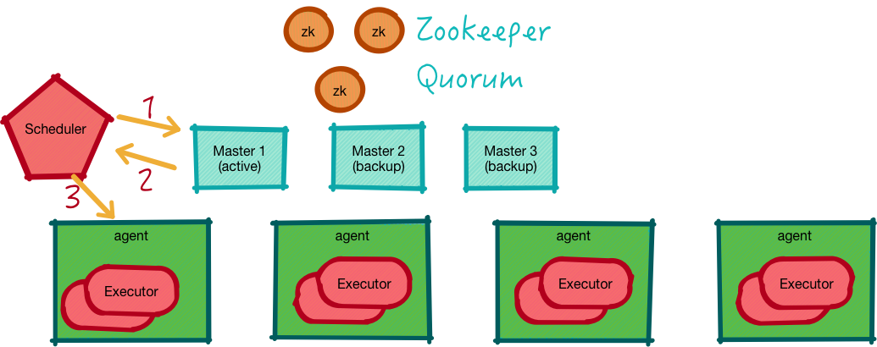
Running Applications on Mesos
Notes:
Instructor Notes:
Explain the application launch process.
Numbers describe the sequence of events.
Participant Notes:
This diagram shows the complete architecture of Mesos.
In addition to Mesos components, we also see application scheduler and executor.
Here is how the process works.
The Application Scheduler negotiates with the Mesos master for resources. It requests resource specifics… need 5 executors with 2CPU and 4GB RAM each.
The master replies back with an offer. Once the scheduler accepts the offer, it tells the master which tasks to deploy.
Tasks are scheduled and run on the executor.

Slide 31

Considerations for Resource Allocation
The Application Scheduler asks the Mesos master for resources:
Need 3 containers, with 4 CPU and 8G RAM each.
The Mesos master evaluates the request:
Considers free resources available in the cluster (from reports from agents).
Consults 'resource policy' rules (how much can be given to to this application).
Then provides resources to the scheduler.
The Scheduler can accept or reject the offering. If accepted, the scheduler will ask the Executor (part of application framework) to launch tasks on the allocated containers.
Notes:
Instructor Notes:
Instructor Notes are the same as Participant Notes.
Please present the Participant Notes.
Participant Notes:
A framework can request resources with certain capacity (for example 2CPU + 4G memory).
It can reject the offers that do not satisfy its requirements.
There is a simple policy called delay scheduling, in which frameworks wait for a limited time to acquire nodes storing the input data.
This can ensure nearly optimal data locality (data lives on the same node where the process tasks are running)

Slide 32
Applications that Work on Mesos
Spark – distributed compute
Cassandra – distributed NoSQL
Kafka – distributed messaging
Notes:
Instructor Notes:
Instructor Notes are the same as Participant Notes.
Please present the Participant Notes.
Participant Notes:
The applications that run on Mesos, should be distributed applications and able to withstand resource failure.
The applications you see here are all distributed applications.
For example, let's say we have a 10 node Cassandra cluster.
Even if we loose say 2 nodes, the Cassandra service will stay up.

Slide 33
Mesos Hardware
Hardware | Master Node | Agent Node
CPU | 4 Cores | 12+ cores
Memory | 32 GB | 256 GBs
Disks | 100+ GB Flash drives recommended | Multiple drives Few terabytes Regular mechanical drives are fine
Notes:
Instructor Notes:
These are some suggestions only.
Participant Notes:
Please note these are suggestions, not requirements.
Tweak these according to your needs.
As you can see master nodes don't need a lot of hardware compared to agent nodes.
Masters do coordination, the actual work is done on agent nodes.
Applications run on Agent nodes. So more CPU and memory are recommended.
Master nodes have mixed IO patterns and can benefit from flash/SSD drives.
Most of the agent nodes have sequential IO patterns, so regular drives will work.

Slide 34

Lab: Mesos Lab
Overview:
In this lab, we will get a Mesos system up and running.
Please refer to the lab document for more details.
Duration:
30-40 minutes
Notes:
Instructor Notes:
Demo the lab on screen. And then have participants complete the lab on their own.
Purpose:
Getting Mesos up and running
Instruction Time Estimate:
30 minutes
Instructions:
Please refer the lab manual
Participant Notes:
Please see lab notes for detailed instructions.

Slide 36
[Instructor Name]

Slide 37
Appendix

Slide 38
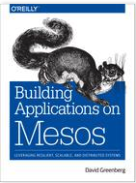
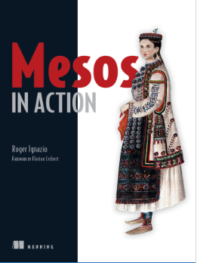
Recommended Reading
Building Applications on Mesos by David Greenberg
Mesos in Action by Roger Ignazio

